Slide 1
Providing state of the art solutions for a technology-driven world.

Slide 2
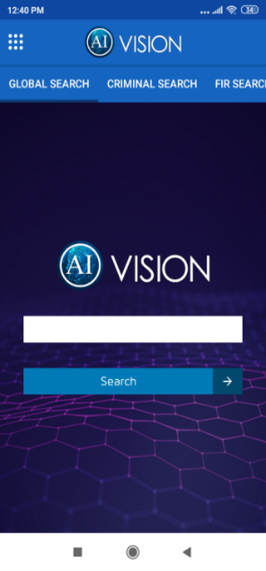
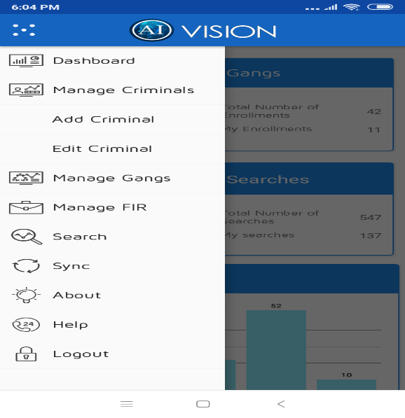
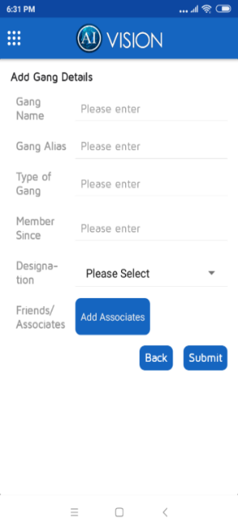
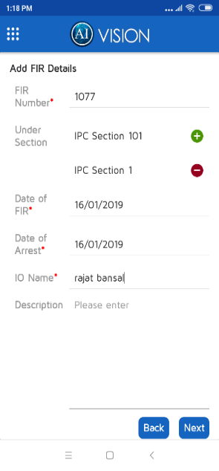
The vision paradigm – Mobile Application
Android Based Mobile Application with ability to create criminal record by capturing different textual (form based) and facial image data of the criminals and amalgamate them to create a unique criminal record
Some indicative features include
Comprehensive search functionality including Facial Recognition based image search and advanced search options
View Top Risk Areas / Hotspots by District/PS etc.
View Top offenders in an Area or Police Station
Perform Crime and Criminal Investigations
Link Associates with a Criminal, Link FIRs with a Criminal, Link Criminals with Gangs etc.
Create a Criminal, Gang and FIR Record – using mobile app or sync with Police database like CCTNS or Criminal Dossier system etc.

Slide 3
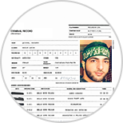
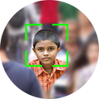
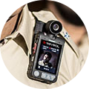
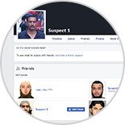
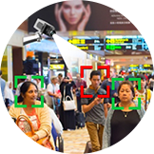
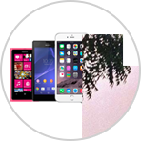
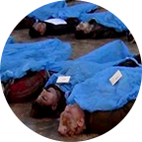
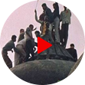
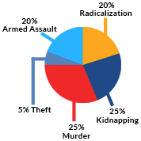
Video and Image Analytics
Unstructured and Structured Datasets
Open Source Intelligence
Metadata
Analysis
CDR
Analysis
INTELLIGENCE ANALYTICAL CENTRE

Slide 4
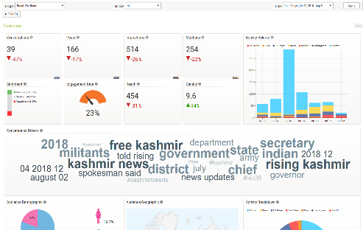
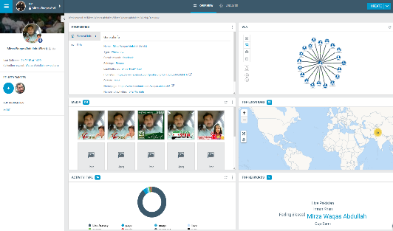
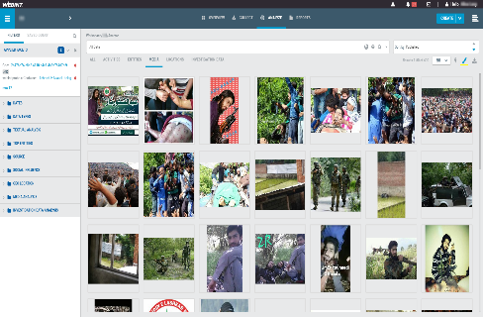
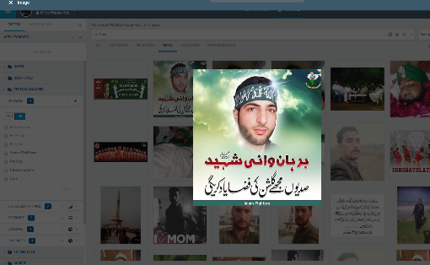
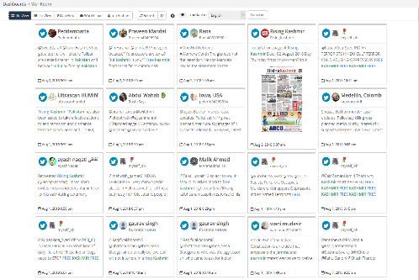
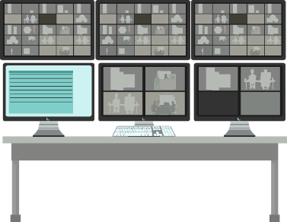
INTELLIGENCE ANALYTICAL CENTRE
Data Ingestion
Analytics Centre– Video, Images, Data
Predictive Intelligence and alerts

Slide 5
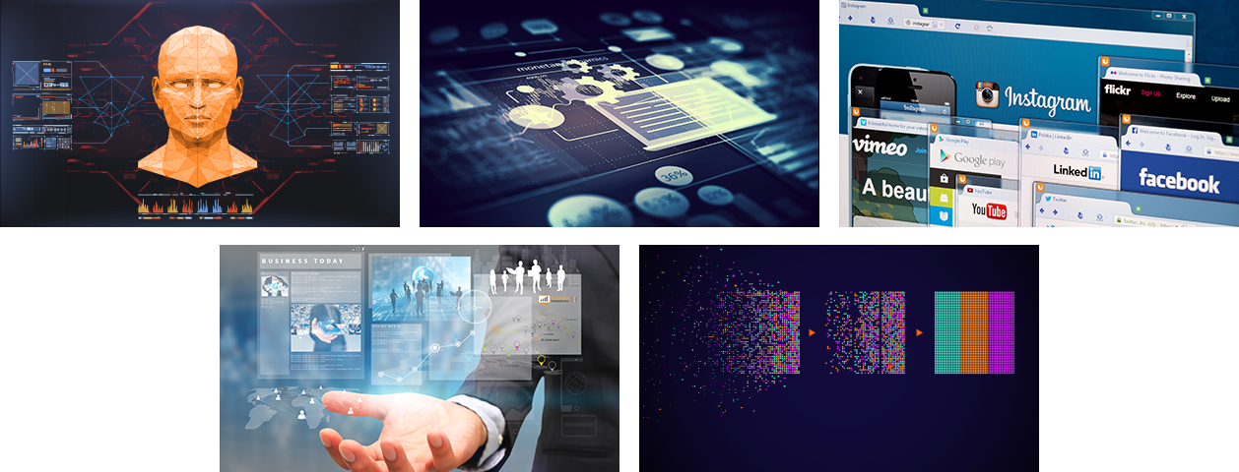
NetMind - Big Data Analytics Solution
A framework with multiple module based on Big Data Analytics, Artifical Intelligence, Natural Language Comprehension, Predictive Modeling and Smarter Analytics.
Computer Vision – Facial Biometrics and Image Analytics
Telecom Metadata Analysis
Open source Databases and Social Media Monitoring
Extract intelligence from unstructured & structured datasets
Call Data Record Analyzer
© 2018 Innefu | Confidential
5

Slide 6
DATA LAKE

Slide 7
Data Gathering and Collection
Police DB
Criminal
Dossier
Intelligence inputs
Interrogation Reports
Vehicle registration database etc.
Open Source Data
Integrating multiple sources of structured, semi-structured and unstructured databases together
Combined Data Lake / Fusion Centre
Analyst

Slide 8
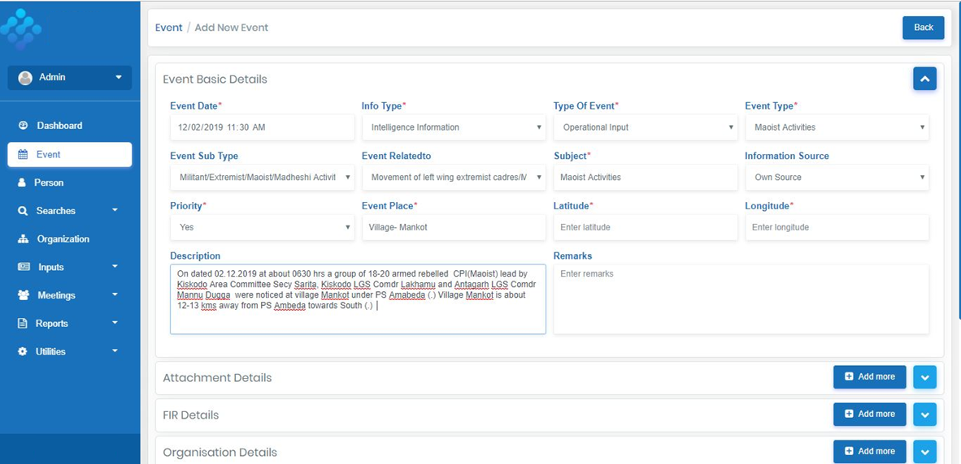
Data Gathering and Collection – Structured Data
Gather data of events / incidents / persons / organizations and upload documents, perform searches etc.
Forms for data collection – with drop down for most of the fields for easy and accurate data collection
Feed Image and Text data of Events / Meetings / Inputs / Incidents / Persons / Organizations / Locations etc.
Feed other structured data – Personality Cards, Organization Cards, Interrogation Reports

Slide 9
Data Gathering and Collection – Unstructured Data
Extracting Intelligence out of raw unstructured data
AI/ML models trained on customers’ data

Slide 10
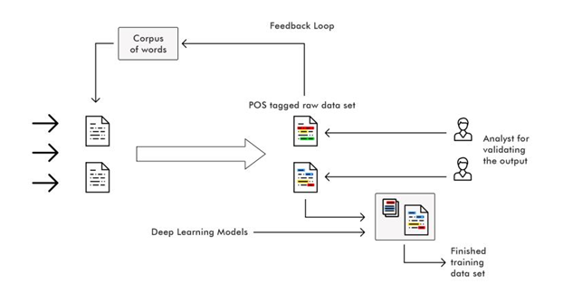
Workflow System
Automate the day to day working of the unit and eliminate much of manual effort
Workflow system for officers to collate data and create daily, weekly, monthly, quarterly reports
Data Validation and daily, weekly, monthly etc. Report Creation and dissemination
Daily inputs get collated every day and get automatically sent to higher officers who can either give feedback for corrections or provide approval at their level for the report to be presented to higher levels

Slide 11
Data Warehouse / Data Lake
Video and Image Analytics
Unstructured and Structured Datasets
Open Source Intelligence
Metadata
Analysis
CDR
Analysis
Data Lake / Data Fusion Centre

Slide 12
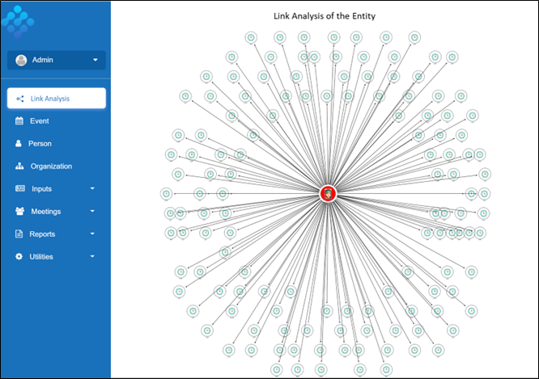
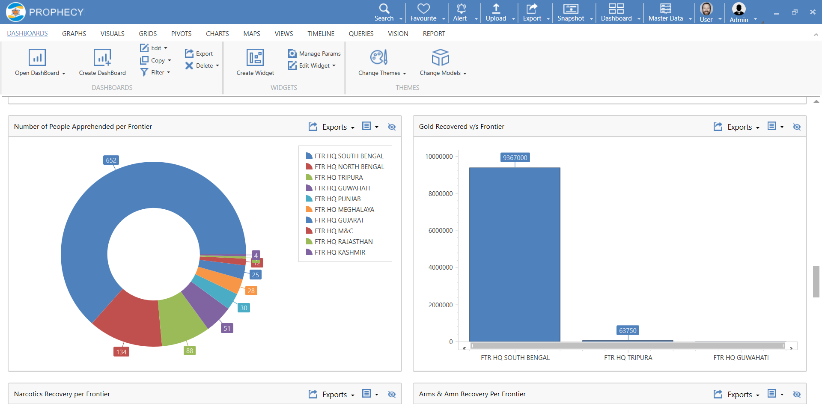
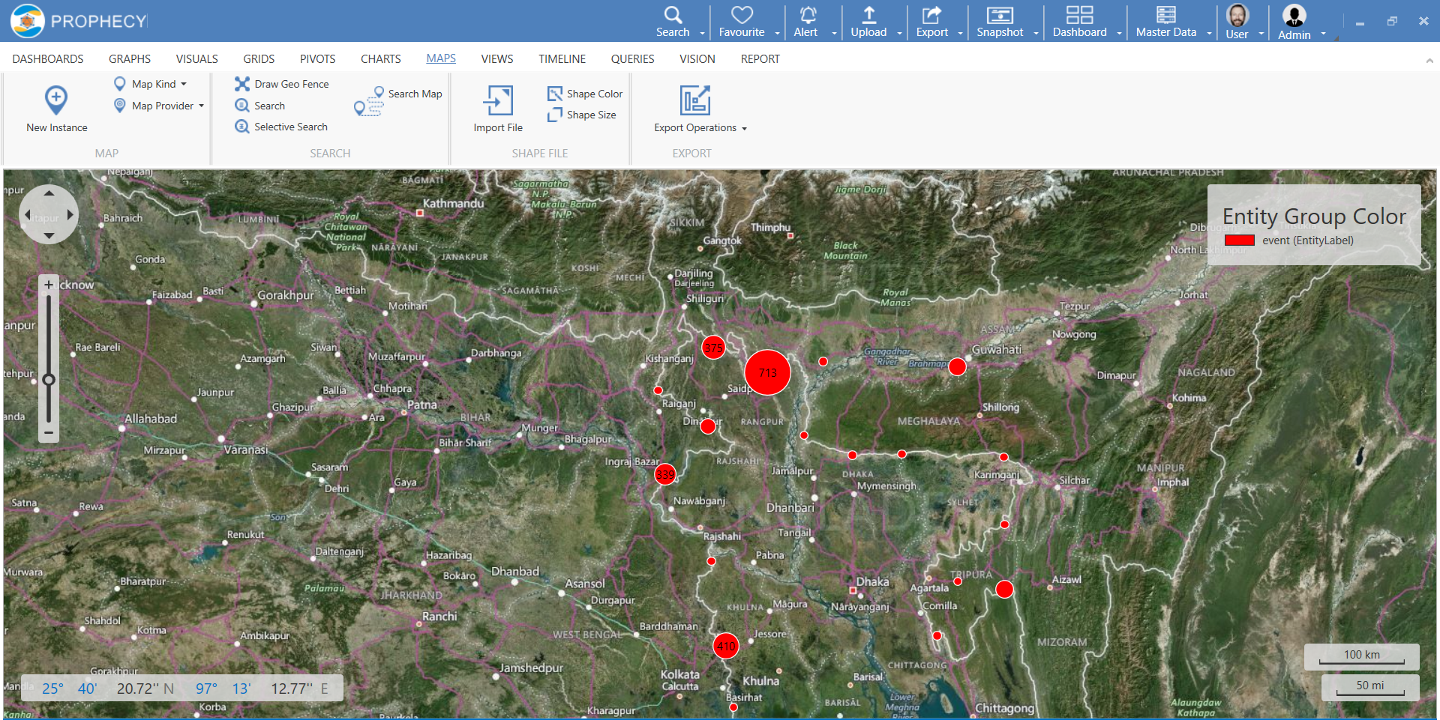
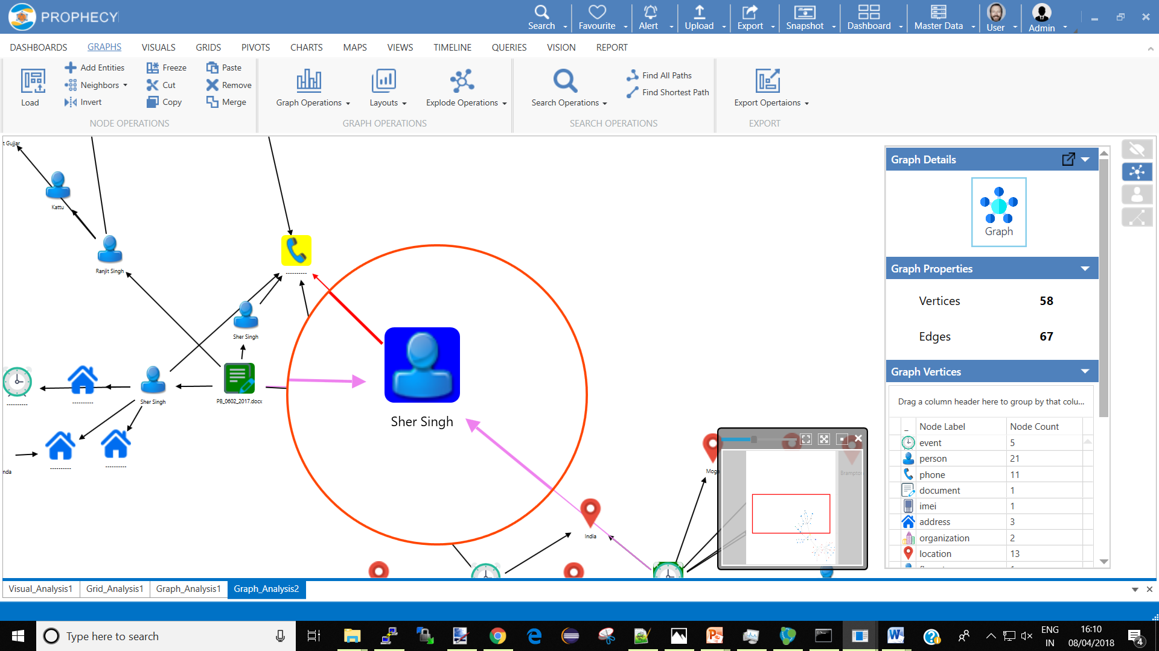
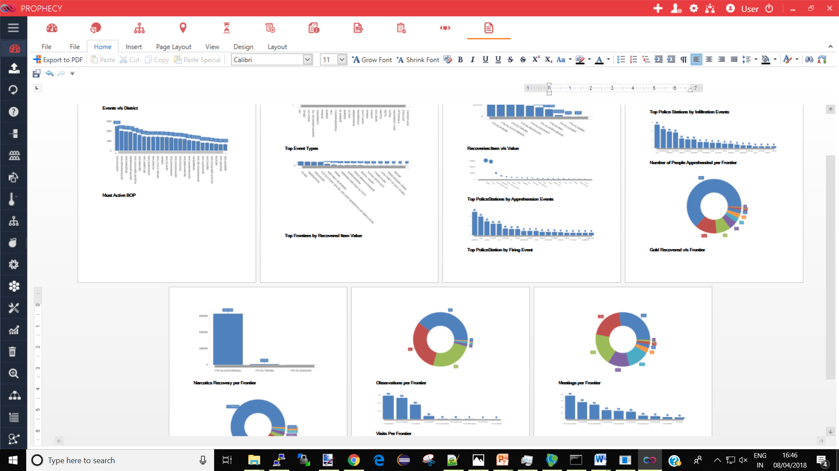
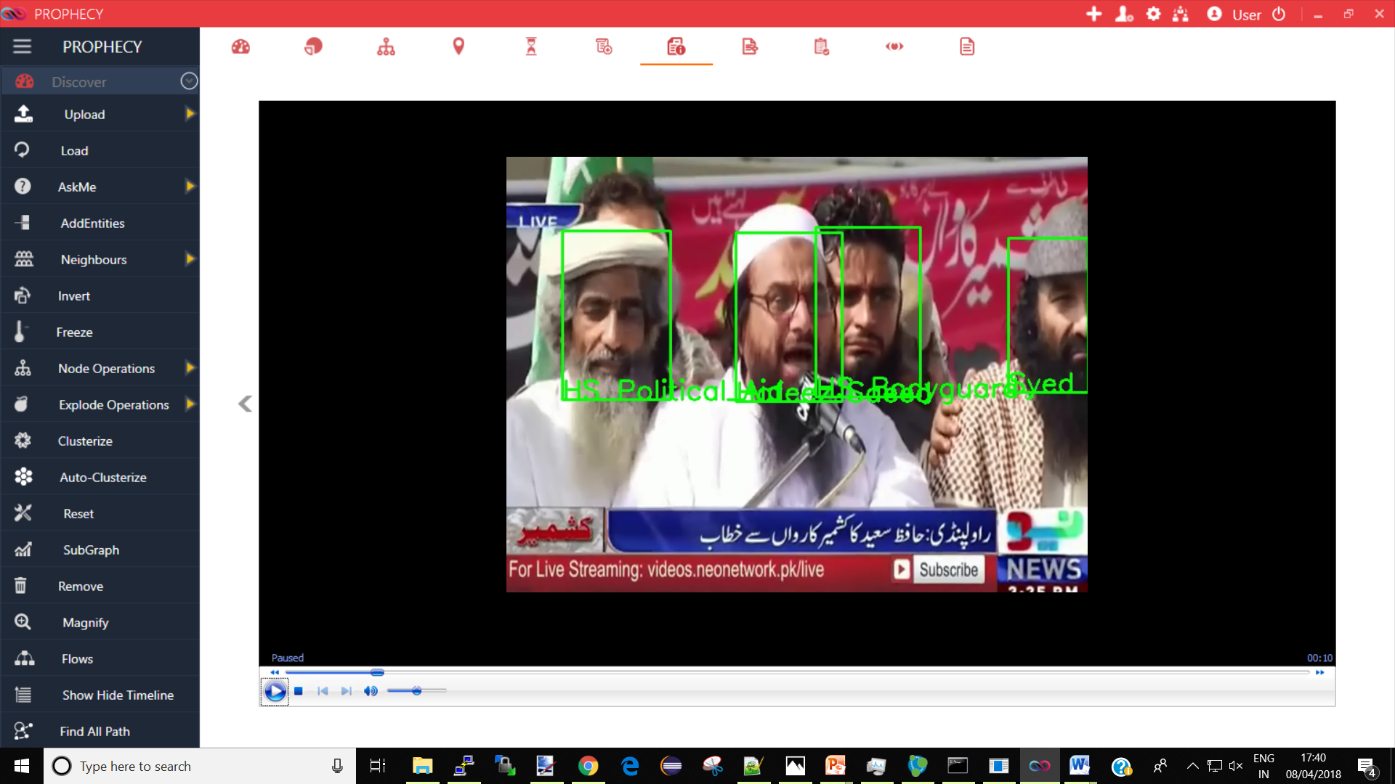
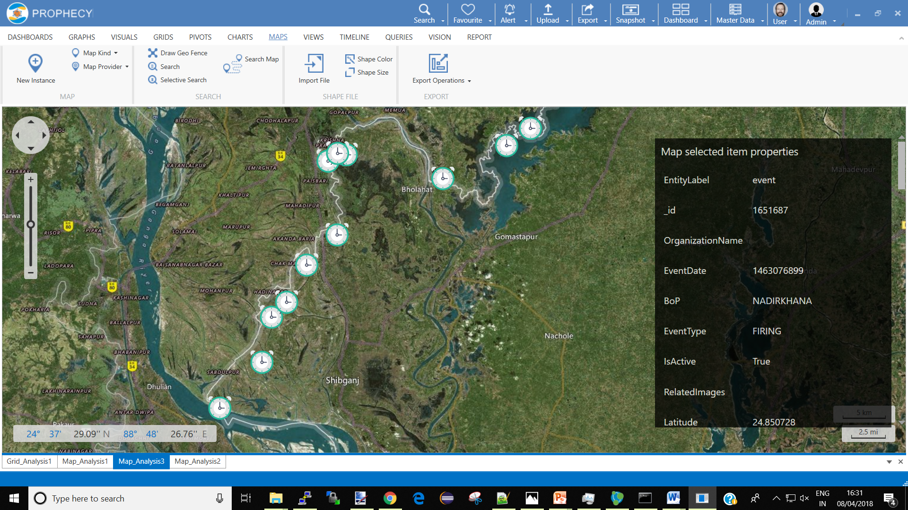
Data Analytics and Visual Analysis
Customized Textual and Visual Charts and Map based Dashboards
Integration with GIS for plotting inputs on maps and generating reports and analyzing patterns on maps
Visual Analysis Platform built to analyze and identify hidden patterns and provide a holistic view from the entire historical data
Extract, transform and collation logics to relate different entities like Events, Inputs, Persons etc. for better analysis
Slicing and dicing of data, entities for visual analysis
Download reports in any format – PDF, Word, Excel etc.
Configurable Dashboard
Geospatial Analysis
Network Link Analysis
Reports and Alerts
Video & Image Analytics
Predictive Intelligence

