Slide 1
Providing state of the art solutions for a technology-driven world.

Slide 2
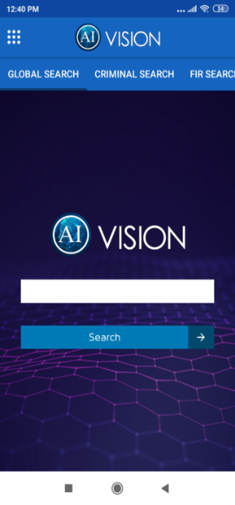
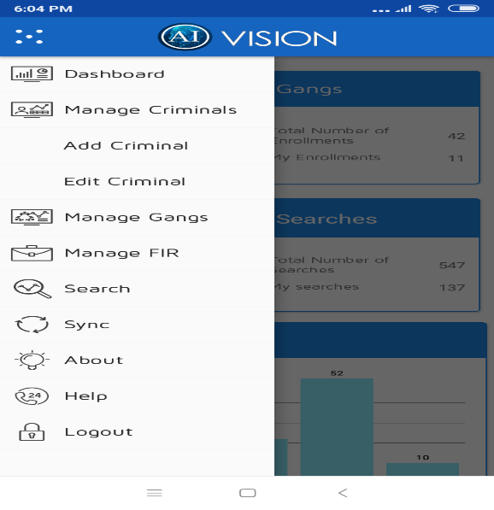
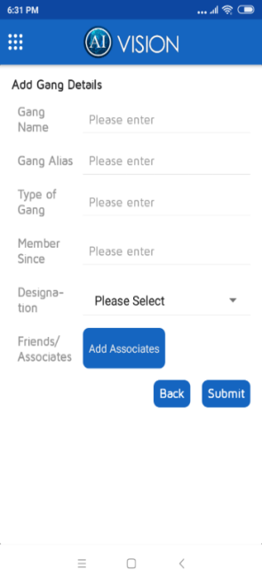
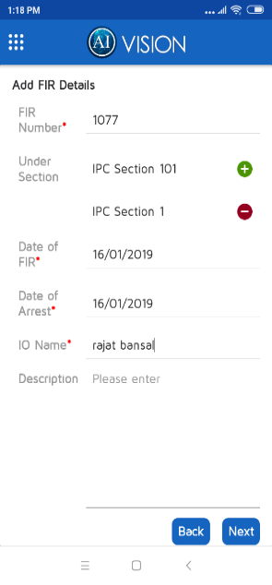
The vision paradigm – Mobile Application
Android Based Mobile Application with ability to create criminal record by capturing different textual (form based) and facial image data of the criminals and amalgamate them to create a unique criminal record
Some indicative features include
Comprehensive search functionality including Facial Recognition based image search and advanced search options
View Top Risk Areas / Hotspots by District/PS etc.
View Top offenders in an Area or Police Station
Perform Crime and Criminal Investigations
Link Associates with a Criminal, Link FIRs with a Criminal, Link Criminals with Gangs etc.
Create a Criminal, Gang and FIR Record – using mobile app or sync with Police database like CCTNS or Criminal Dossier system etc.

Slide 3
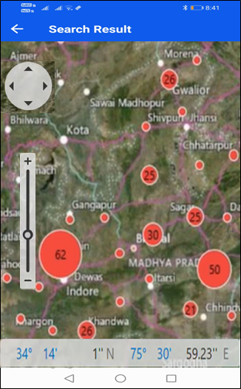
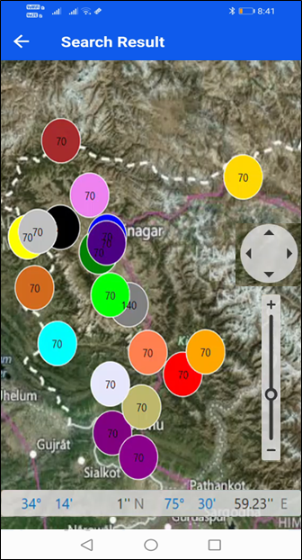
Top Risk Areas under District / P.S. and Crime Hotspots

Slide 4
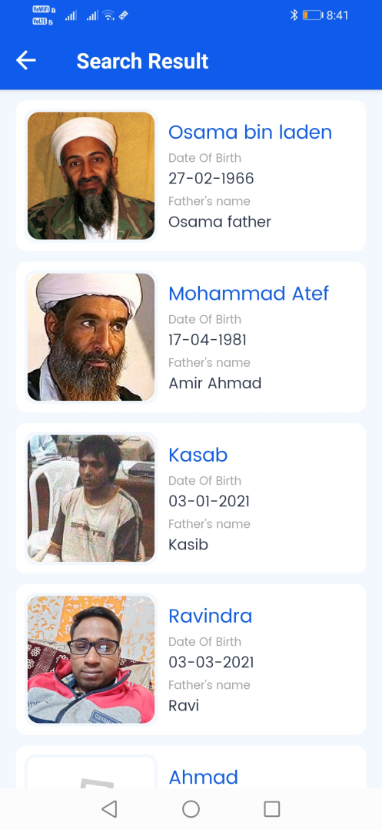
Top Offenders in the Area/Police Station

Slide 5
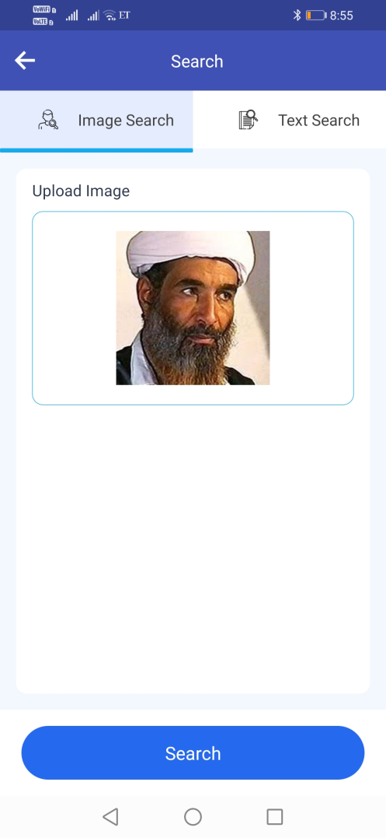
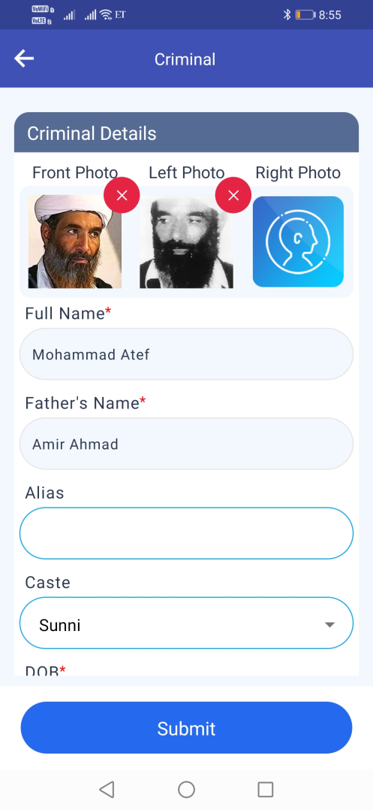
FRS – Facial Recognition based Search

Slide 6
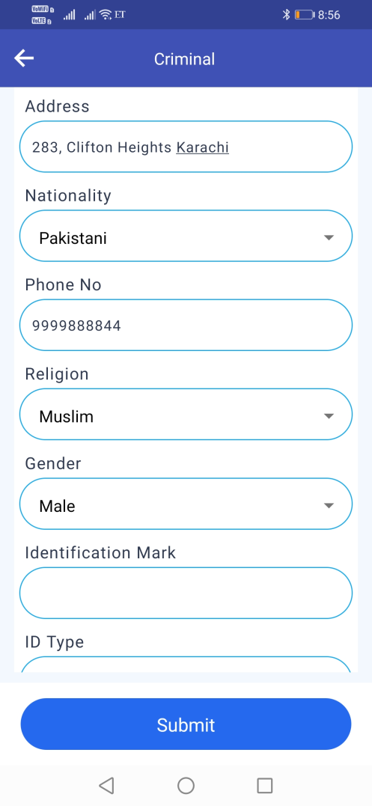
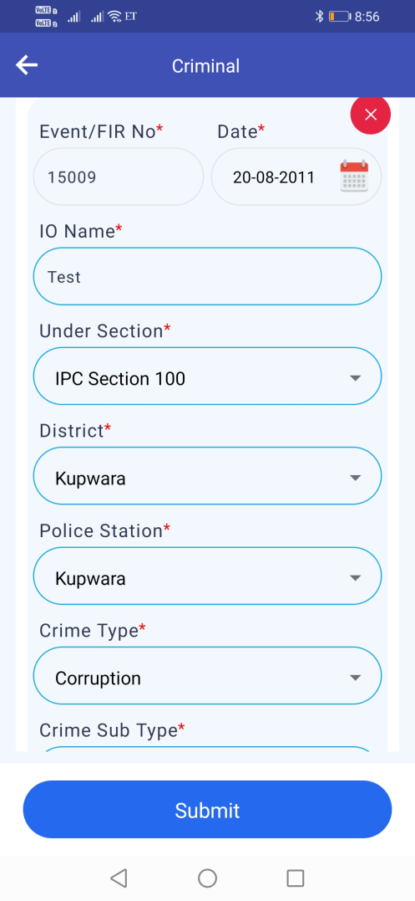
Perform Crime and Criminal Investigations

