Slide 1
Providing state of the art solutions for a technology-driven world.
Smart Health Solution

Slide 2
Solution
Smart Card Solution
64kb Smart Card
Automation of Health Units
HIMS
Authentication Mechanism (KIOSK) at Empanelled Facilities
Beneficiary Mobile App

Slide 3
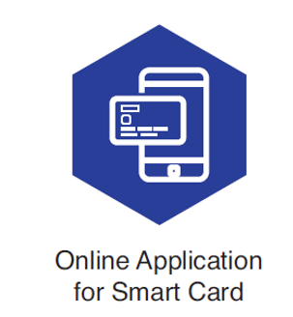
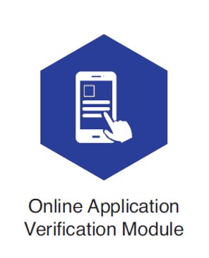
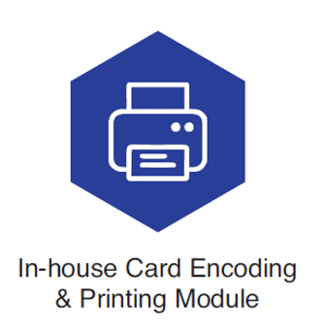
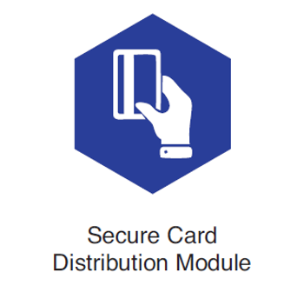
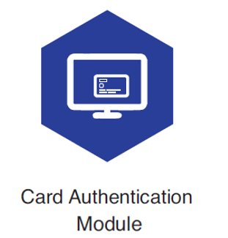
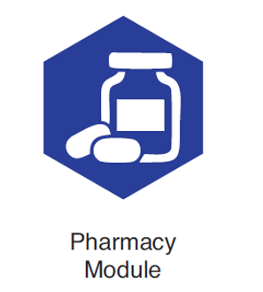
Major Components of the solution
LIVEDOCT
HIMS

Slide 4
Process Flow
Beneficiary registers with Mobile number.
Fills & submits the online application
along with online payment.
Record Office
Application is online
Verified & Approved
Beneficiary visits CSC counter.
VLE fills & submits the online application
along with online payment.
Regional Center
Smart Health Card is encoded & Printed in-house
Smart Cards dispatched
Station HQ / Polyclinic Generates OTP and
handover the cards to
Beneficiaries by OTP validation.

Slide 5
Smart Card at Health Units
Process Flow
Beneficiary visits Polyclinic
with Smart Card
Verification with National ID DB - Enabled
Health Units
KIOSK at Polyclinic authenticates beneficiary with Smart Card using PIN.
Beneficiary can select doctor for consultation.
KIOSK also updates medical & Pharmacy records on smart cards.
Beneficiary books online appointment via mobile app
Doctor provides consultation
to beneficiary.
Doctor can prescribe medicines to beneficiary
Doctor can also generate referral letter for Empanelled facilities
Medicines are issued by pharmacy as prescribed by consulting doctors
OIC provides approval for referral letters
Pharmacy provides prescription printout to beneficiary.
Referral letter details are auto-populated in hospital portal.
Application is integrated with BPA

Slide 6
Current Traction
Automation of 431 Polyclinics/Health Units
Approximate 700 touchpoints
Integration with more than 4 Lakh VLE CSE
Approx. 55 Lakh Smart Cards Printed and Distributed
Average of 60,000 footfalls on a daily basis in 431 health units
2821 Empaneled Hospitals

Slide 7
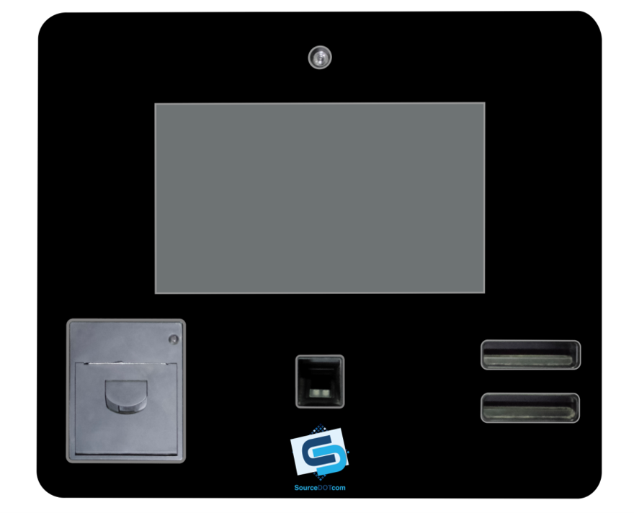
Wall Mount Kiosk / Self Registration & Authentication Terminal
Camera
Touch Screen
Thermal Printer
Card Reader
Biometric

Slide 8
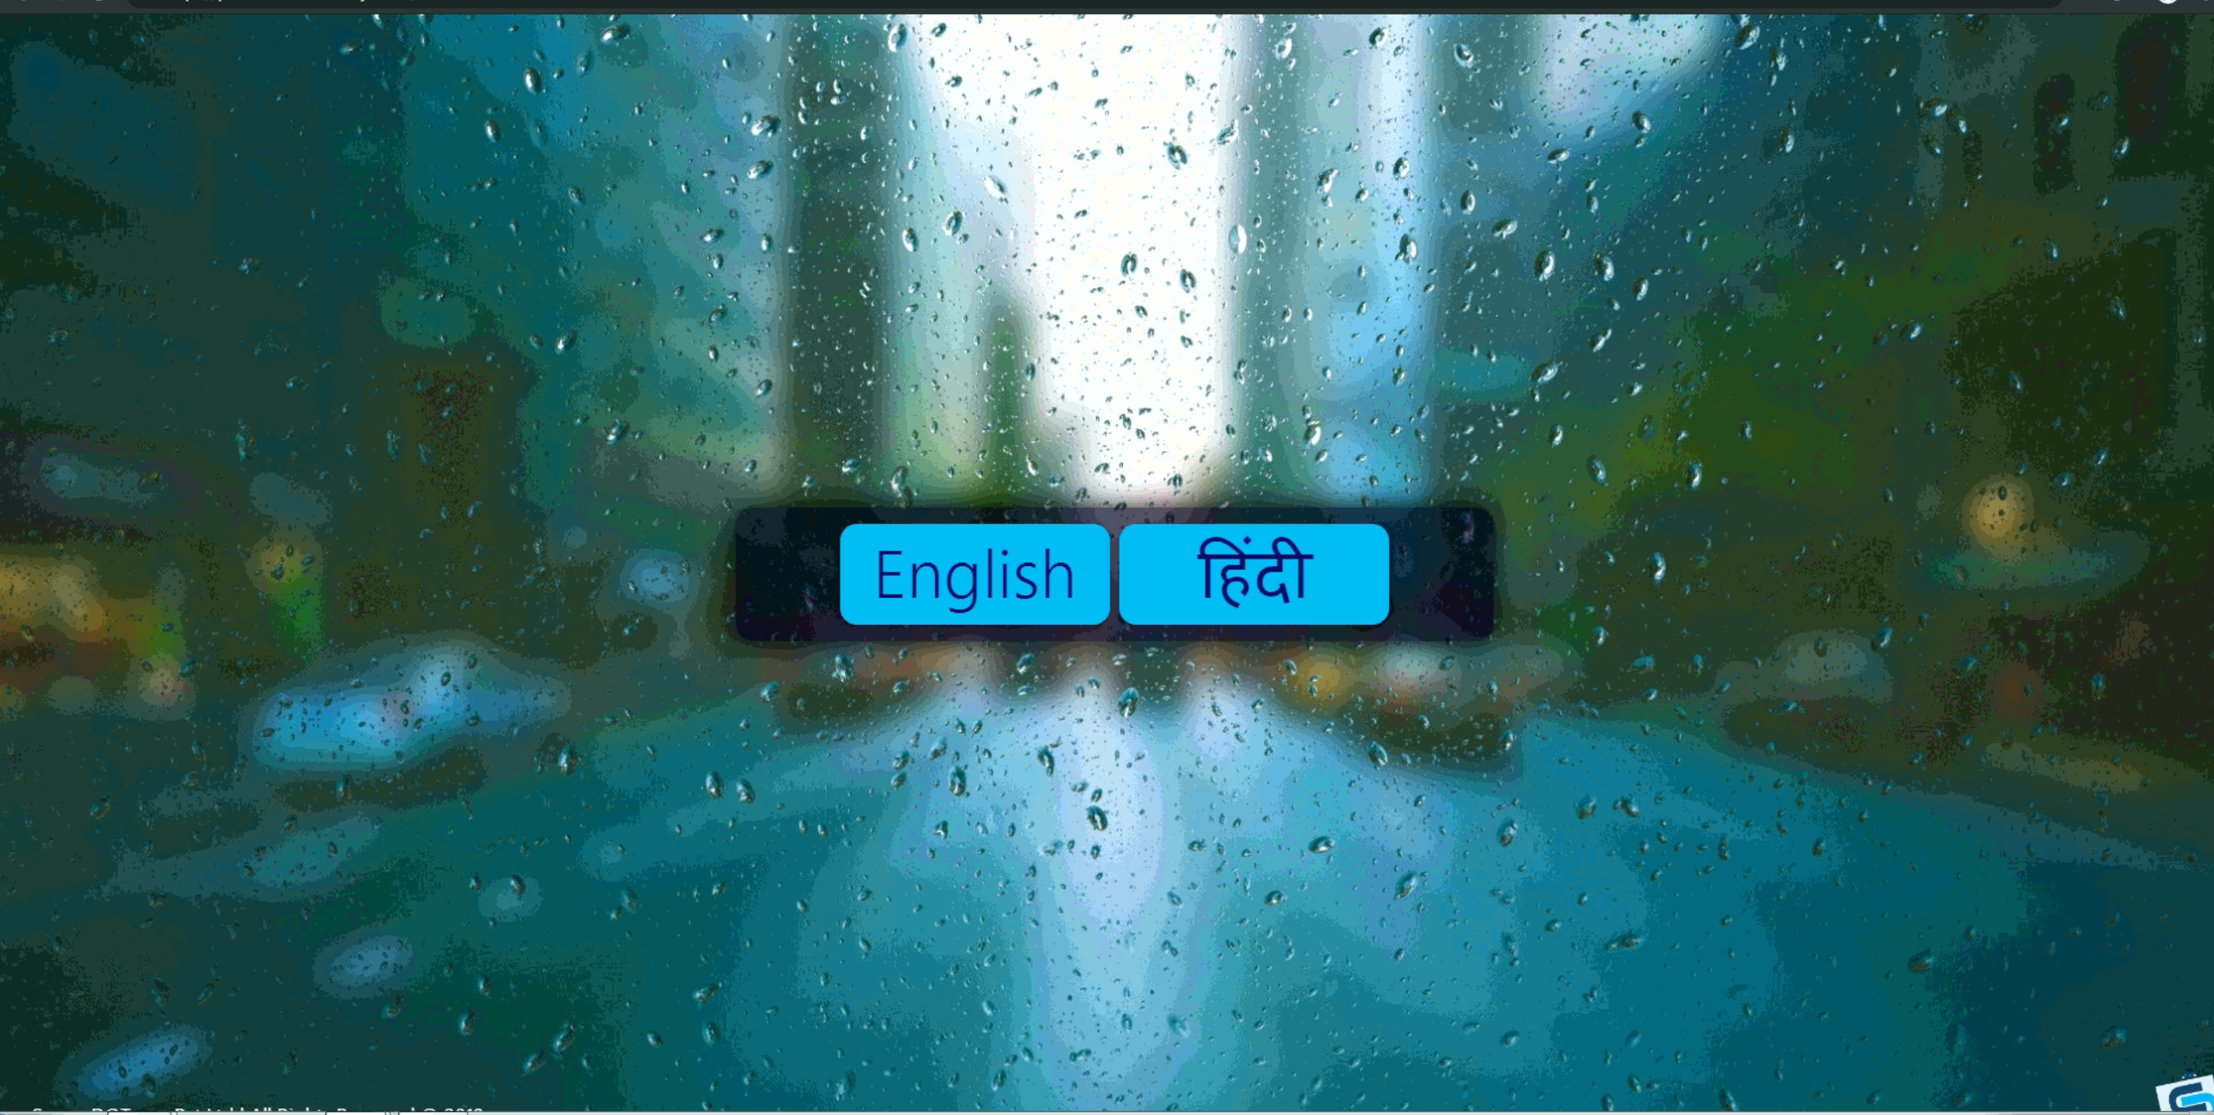
Kiosk Home Screen

Slide 9
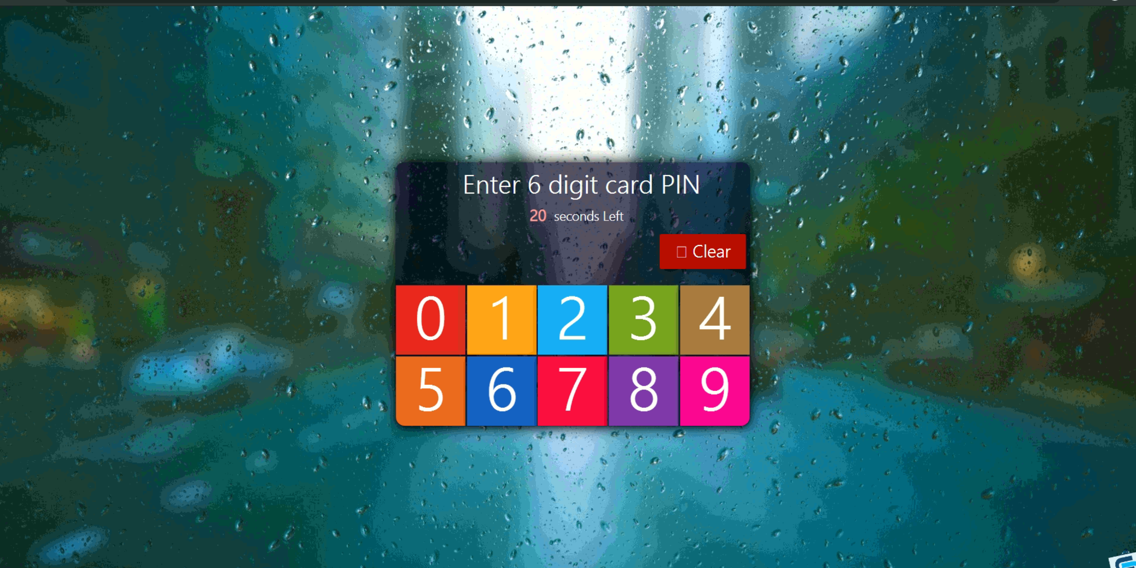
Card PIN based authentication

Slide 10
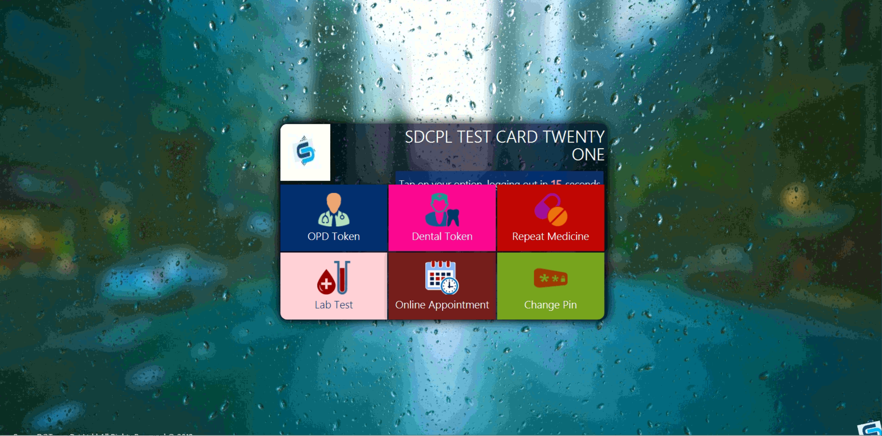
Beneficiary Dashboard at Kiosk

Slide 11
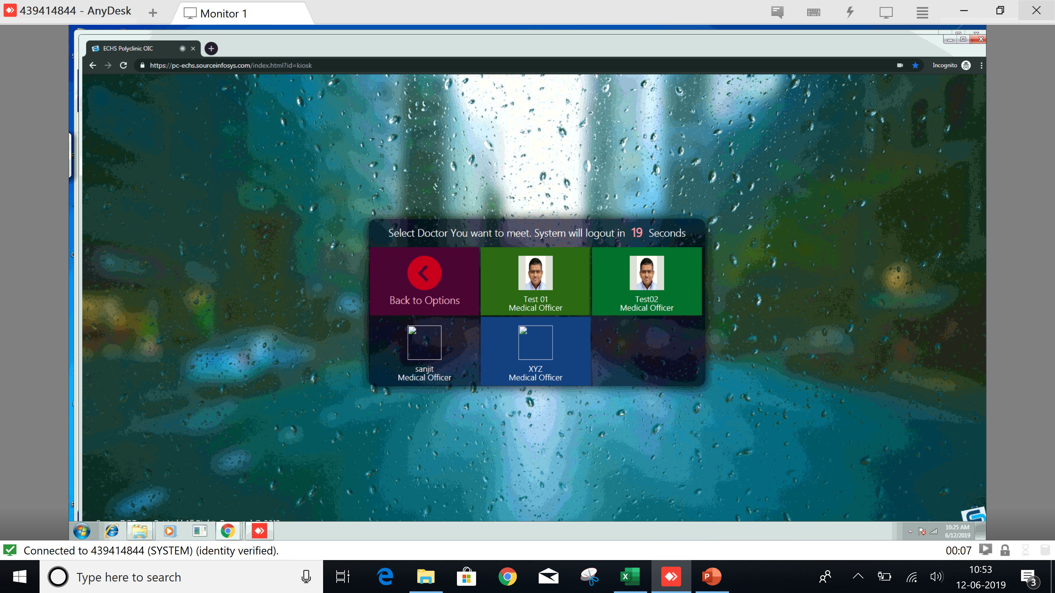
Appointment for Doctors

Slide 12
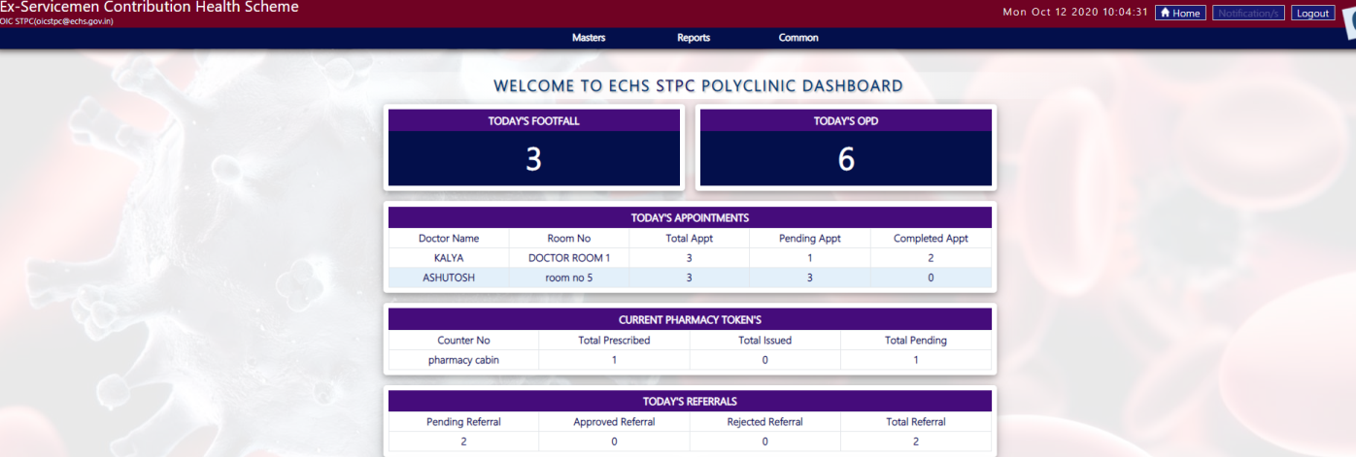
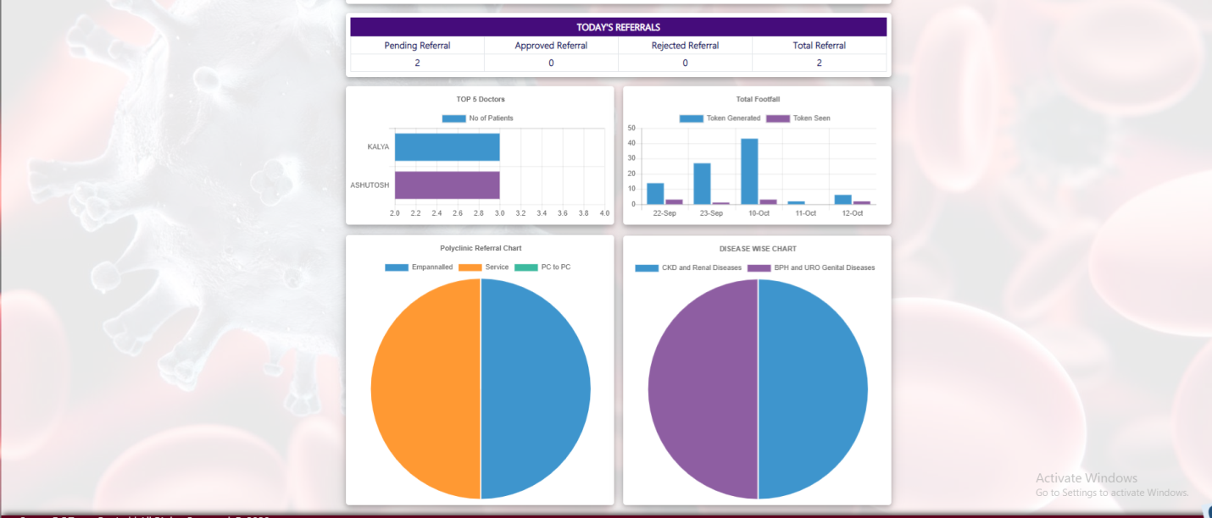
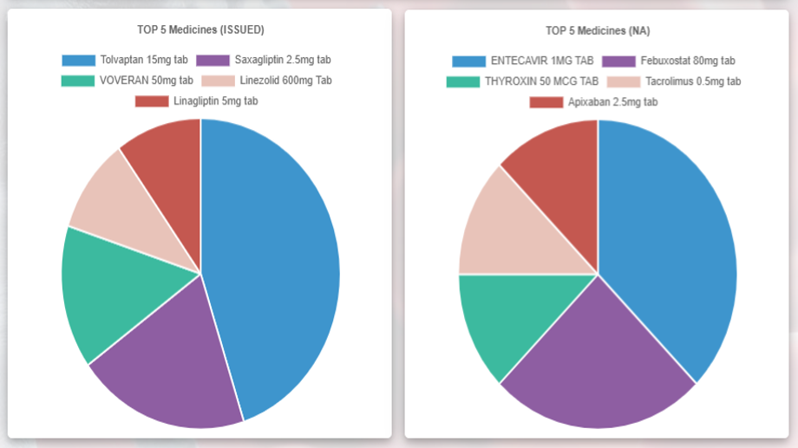
Admin Module Dashboard

Slide 13
Doctor’s Module

Slide 14
Doctor’s Referral Generation Module

Slide 15
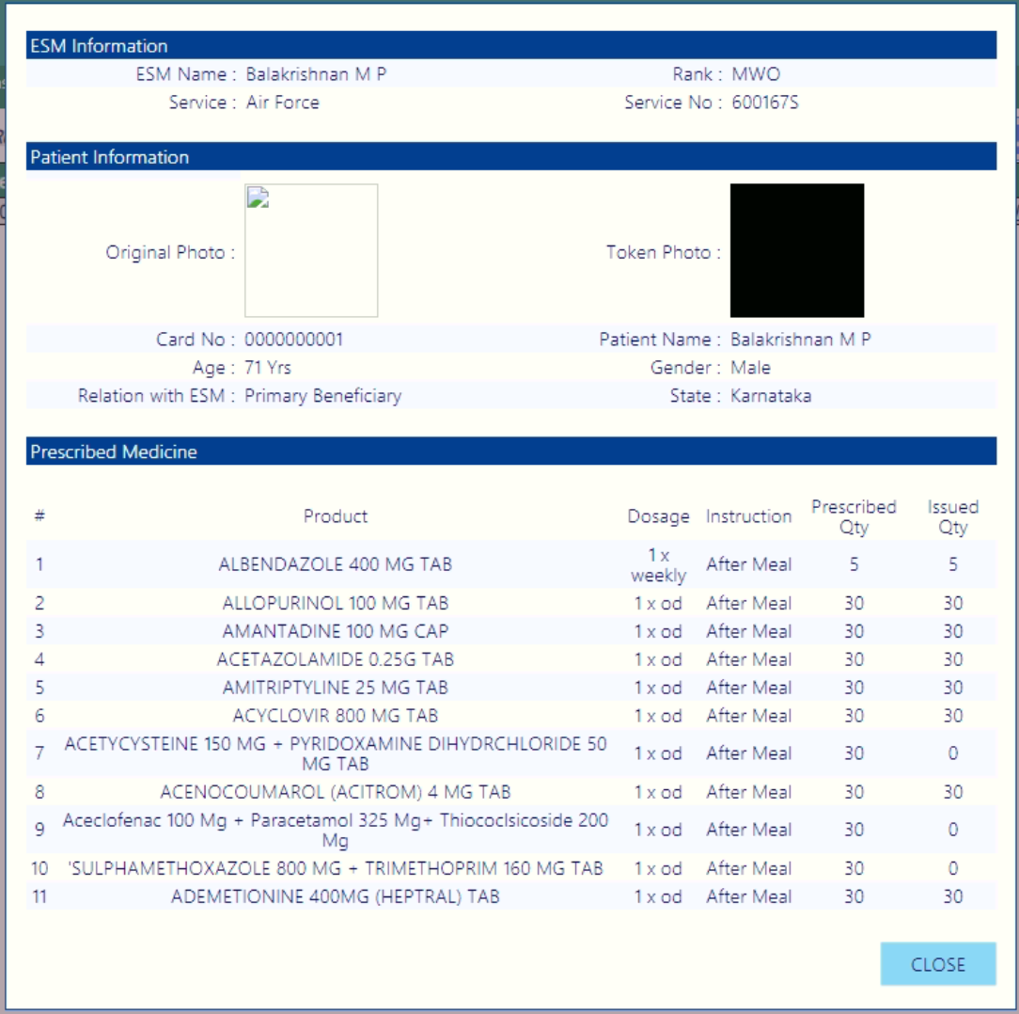
Pharmacist Medicine Distribution Screen

Slide 16
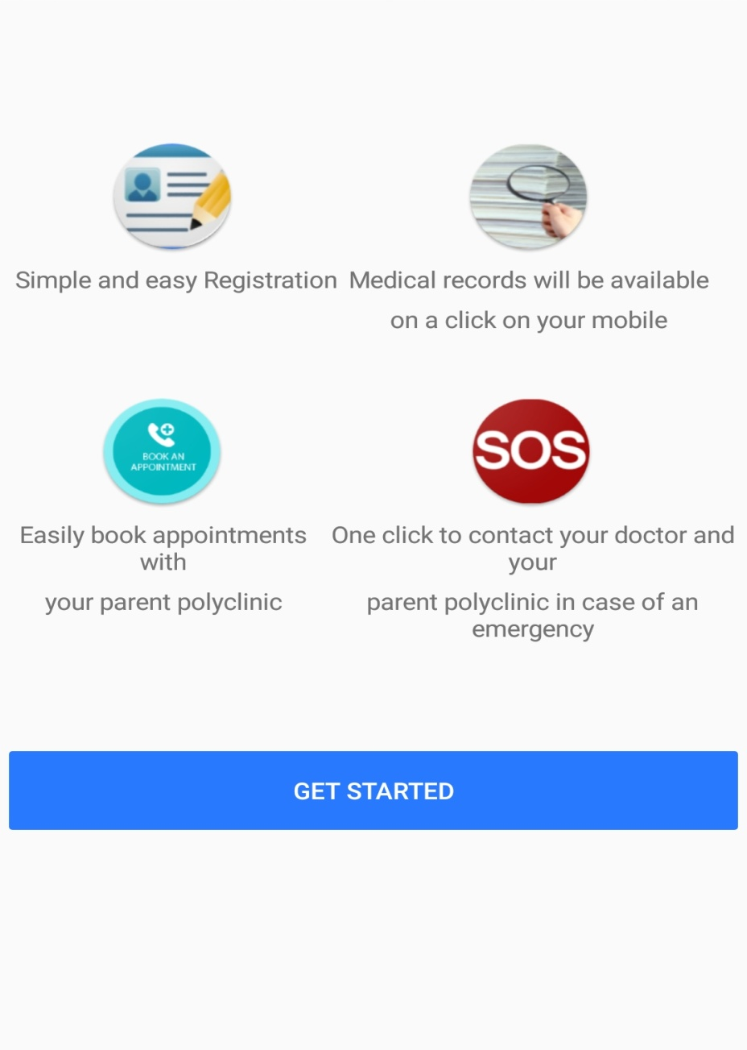
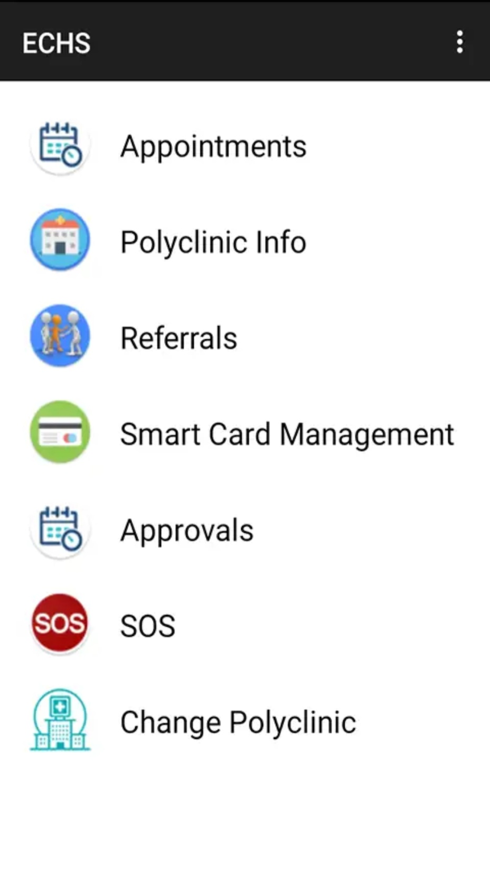
Beneficiary Mobile App

Slide 17
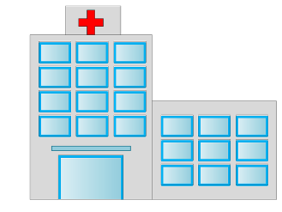
Referral Process at Empaneled Facilities
TPA
Accepts via Referral Number.
Details are auto-populated in TPA application.
Beneficiary visits Empanelled
Facility with Referral Letter
Integration
Advantages in our Solution:
Can be integrated with TPA.
Beneficiary need not to wait for approvals.
A referral Number once activated at Empanelled Facility same cannot be reused.
Data can be made available on mobile app on real time basis.

