Slide 1
Providing state of the art solutions for a technology-driven world.
Virtual Police Booth

Slide 2
Introduction to Virtual Police Booth
An interactive information kiosk with touch & multi-lingual support.
For verticals lodging of complaints.
For citizen to interaction with Police Department without visiting one.
For instantly requesting assistance by calling the remote police control over audio/video.
Registering the complaint through virtual police booth.
Option to upload necessary documents with inbuilt HD Cam Scanner.
The Virtual Police Booth offers unique three-in-one functionality:
It can be used to advertise about pressing issues of the society and also will help to spread awareness about any topic.
The kiosk will also become an audio/video call center enabling to easily lodge a complaint with an option to scan and upload the documents.
It is an intuitive multi-touch information helpdesk.

Slide 3
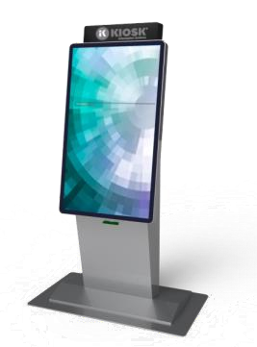
Process Flow
To file complain
Audio/Video Call
Applicant to visit Virtual
Police Booth.
KIOSK at Virtual Police
Booth
Officer at control room updates complaint details as provided by applicant.
allows to raise
complaint without visiting Police Station.
Also allows Audio/Video assistance with officer at control room.
File complaint via KIOSK
Officer can also request for documents from applicant if
required. Same can be
via
in
provided by applicant web camera available KIOSK.

Slide 4
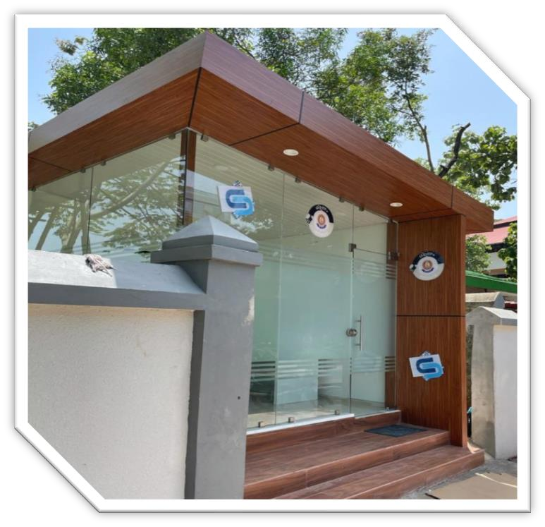
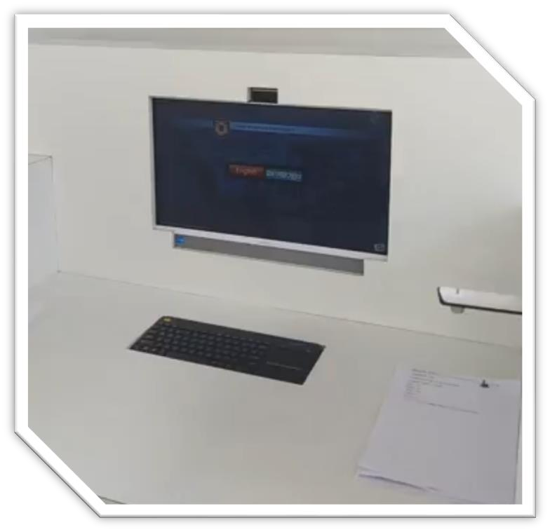
Virtual Police Booth - Modules
Kiosk module
Multi-lingual support.
Audio/Video conferencing tools
Complaint without an audio/video call.
Update documents through KIOSK.
Printing of complaint copy through KIOSK.
Virtual Police Booth
KIOSK at Virtual Police Booth

Slide 5
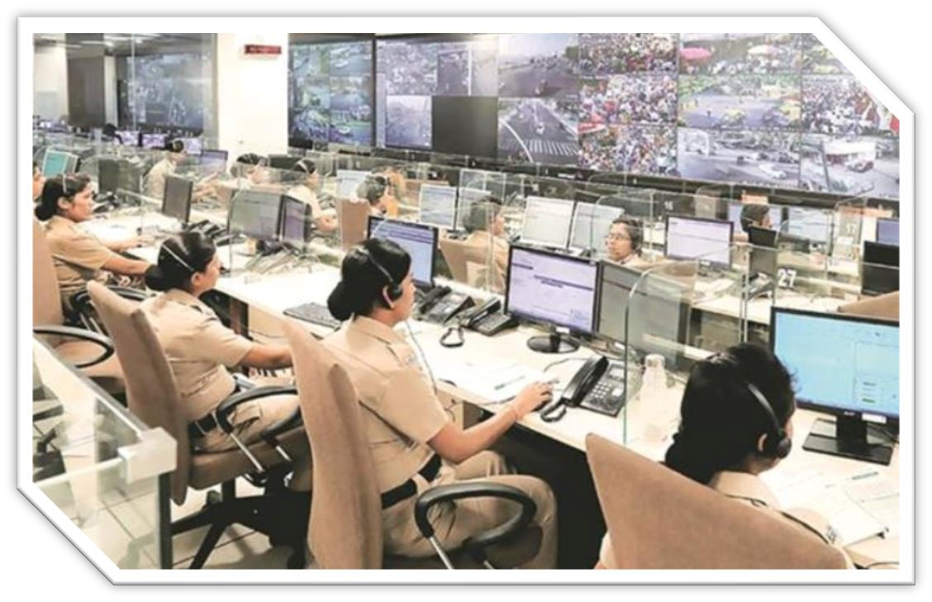
Virtual Police Booth - Modules
The Control Room
Main engine rooms of a police force.
Direct communication with KIOSK.
Audio/Video communication with applicant.
Officer at Control Room

Slide 6
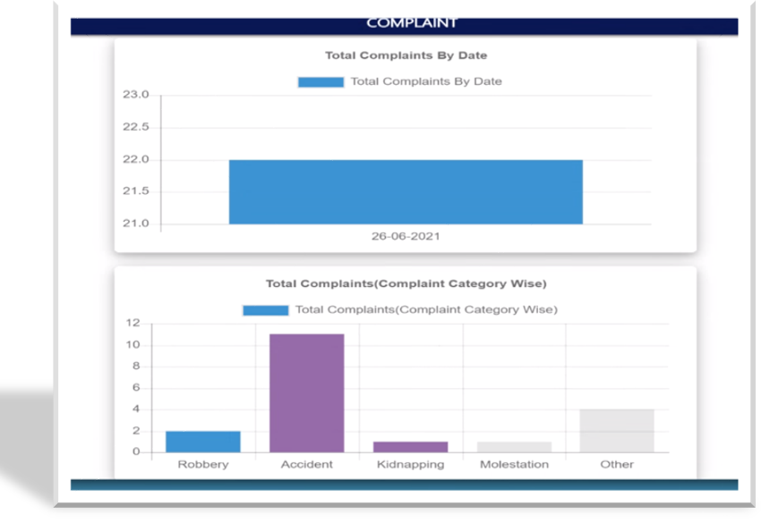
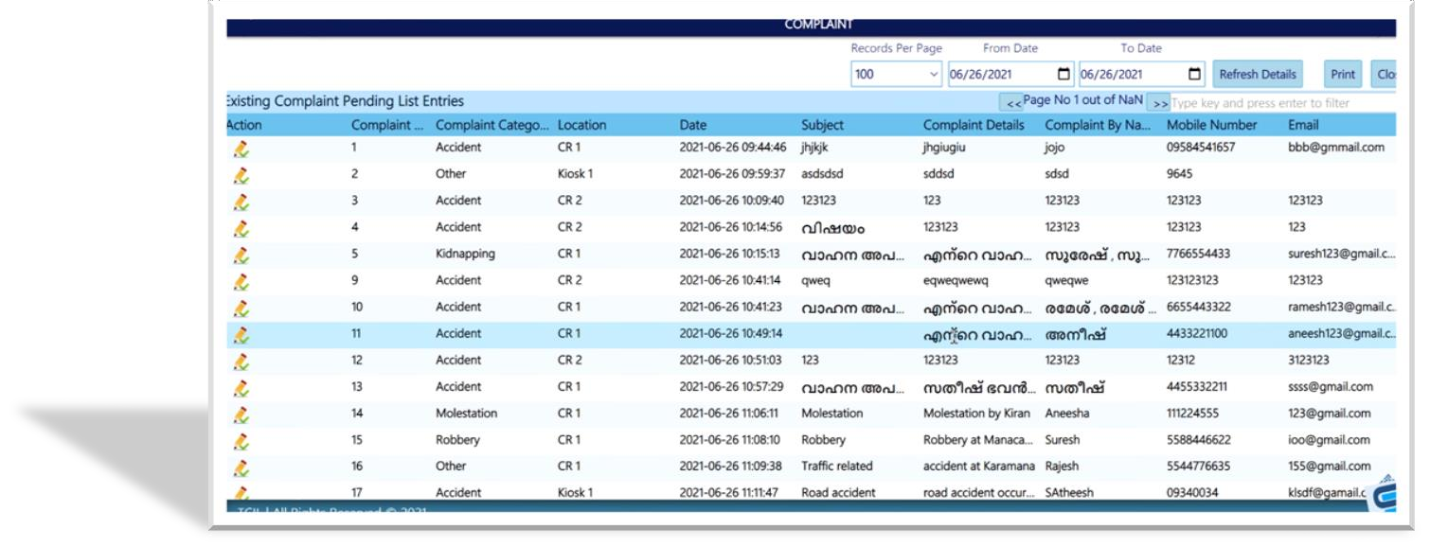
Virtual Police Booth - Modules
Admin/Mis Console
To view list of all the registered complaints.
Availability of all documents.
Availability of real time status of complaints.

Slide 7
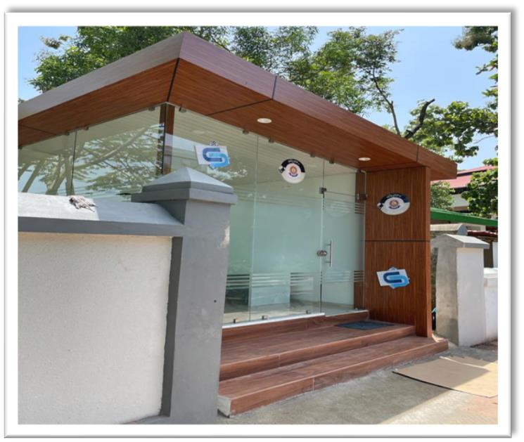
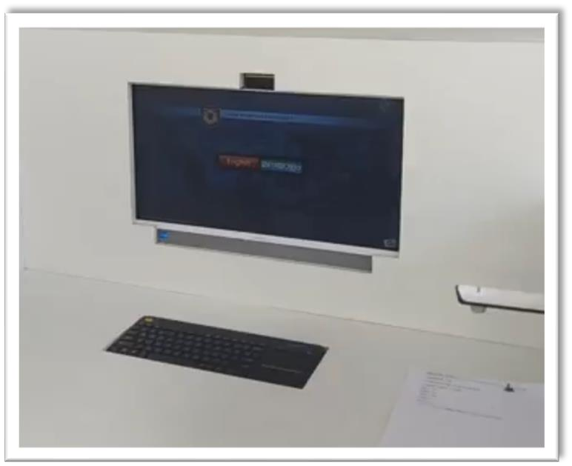
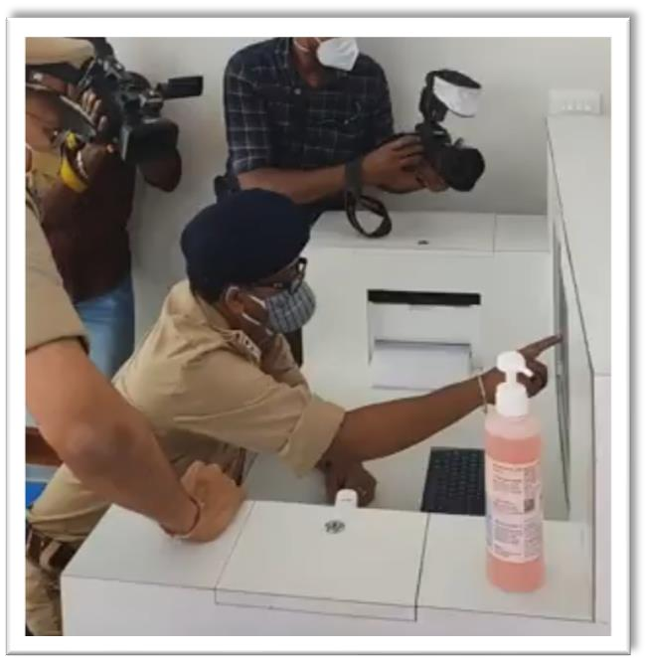
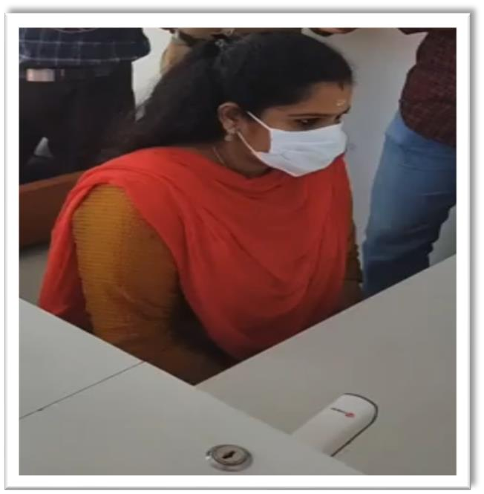
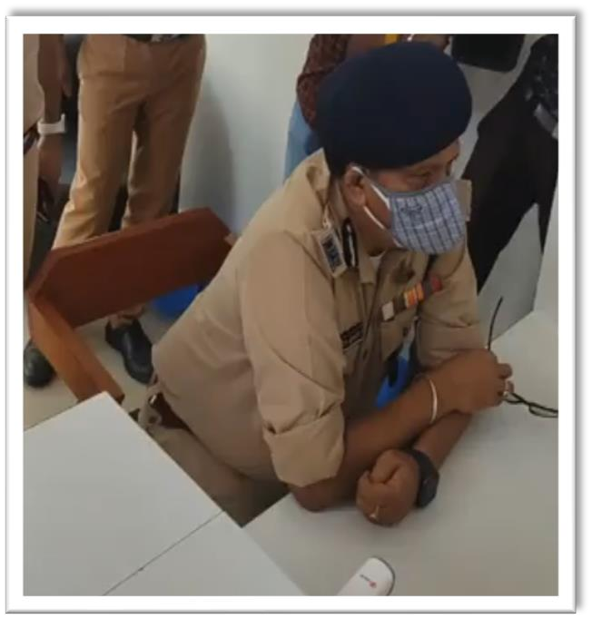
Virtual Police Booth

